Slide 1
Mehran S. Fallah September 2020
Programming Languages
Session 0
Introduction

Slide 2
Some Basic Definitions
A complete description of a programming language includes the computational model, the syntax, the semantics, and the pragmatic considerations that shape the language.
A computational model is a collection of values and operations.
A computation is the application of a sequence of operations to a value to yield another value.
A program is a specification of a computation.
A programming language is a notation for writing programs.
The syntax of a programming language refers to the structure or form of programs.
The semantics of a programming language describes the relationship between the syntactical elements and the model of computation.
The pragmatics of a programming language describes the degree of success with which a programming language meets its goals both in its faithfulness to the underlying model of computation and in its utility for human programmers.

Slide 3
Models of Computation
Computational models begin with a set of values. The values can be separated into two groups, primitive and composite.
The primitive values are usually numbers, Boolean values, and characters.
The composite values are usually arrays, records, and recursively defined values. Strings may occur as either primitive or composite values. Lists, stacks, trees, and queues are examples of recursively defined values.
Associated with the primitive values are the usual operations (e.g., arithmetic operations for the numbers). Associated with each composite type are operations to construct the values of that type and operations to access component elements of the type.
There are three basic computational models—functional, logic, and imperative.
The functional model of computation consists of a set of values, functions, and the operation of function application.
Functions may be named and may be composed with other functions.
Functions can take other functions as arguments and return functions as results.

Slide 4
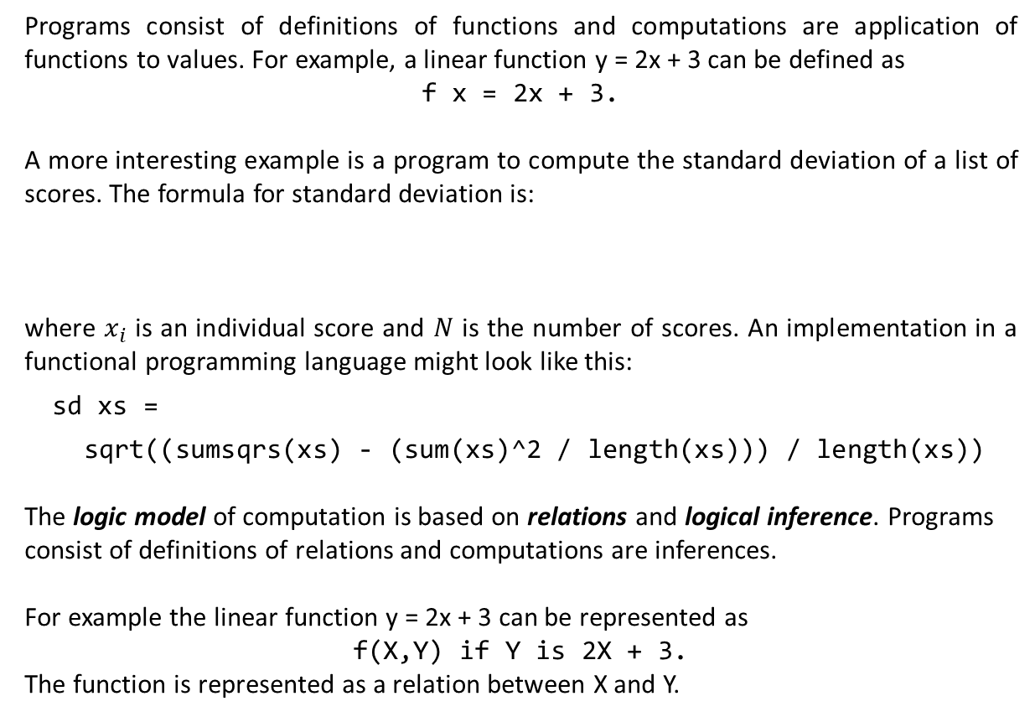
Models of Computation (Ctd.)
Programs consist of definitions of functions and computations are application of functions to values. For example, a linear function y = 2x + 3 can be defined as
f x = 2x + 3.
A more interesting example is a program to compute the standard deviation of a list of scores. The formula for standard deviation is:
where $x_{i}$ is an individual score and $N$ is the number of scores. An implementation in a functional programming language might look like this:
sd xs =
sqrt((sumsqrs(xs) - (sum(xs)^2 / length(xs))) / length(xs))
The logic model of computation is based on relations and logical inference. Programs
consist of definitions of relations and computations are inferences.
For example the linear function y = 2x + 3 can be represented as
f(X,Y) if Y is 2X + 3.
The function is represented as a relation between X and Y.

Slide 5
Models of Computation (Ctd.)
A more typical application for logic programming is illustrated by a program to determine the mortality of Socrates.
Suppose we have the following set of sentences.
1. man(Socrates)
2. mortal(X) if man(X)
The first line is a translation of the statement Socrates is a man. The second line is a translation of the phrase all men are mortal into the equivalent for all X, if X is a man then X is mortal.
To determine the mortality of Socrates. The following sentence is added to the set.
¬ mortal(Y).
This sentence is a translation of the phrase There are no mortals rather than the usual phrase Socrates is not mortal. It can be viewed as the question, “Is there a mortal?”
Steps of the computation are as follows:

Slide 6
Models of Computation (Ctd.)
The first step in the computation is illustrated here
1. man(Socrates)
2. mortal(X) if man(X)
3. ¬ mortal(Y)
4. ¬ man(Y)
The deduction of line 4 from lines 2 and 3 is to be understood from the fact that if the conclusion of a rule is known to be false, then so is the hypothesis (modus tollens).
Using this new result, we get a contradiction with the first sentence.
1. man(Socrates)
2. mortal(X) if man(X)
3. ¬ mortal(Y)
4. ¬ man(Y)
5. Y = Socrates
From the resolvent and the first sentence, resolution and unification produce Y = Socrates. That is, there is a mortal and one such mortal is Socrates. Resolution is the process of looking for a contradiction and it is facilitated by unification which determines if there is a substitution which makes two terms the same.

Slide 7
Models of Computation (Ctd.)
The imperative model of computation consists of states and the operation of assignment which is used to modify the states. Programs consist of sequences of commands and computations are changes of the state.
For example, the linear function y = 2x + 3 written as Y := 2X + 3 requires the implementation to determine the value of X in the state and then create a new state which differs from the old state in that the value of Y in the new state is the value that 2X + 3 had in the old state.
Old State: X = 3, Y = -2, ...
Y := 2X+3
New State: X = 3, Y = 9, ...
The imperative model is important because it models change and changes are part and parcel of our environment. In addition, it is the closest to modeling the hardware on which programs are executed. This tends to make it the most efficient model in terms of execution speed.

Slide 8
Introduction to Programming Languages by Anthony Aaby
You may begin doing exercises of Chapter 1.

